Slide 1

Industrial Chemistry
The Contact Process

Slide 2

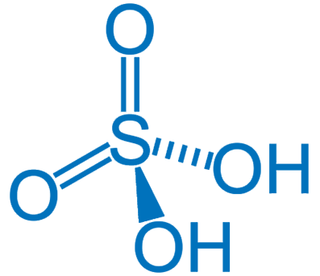
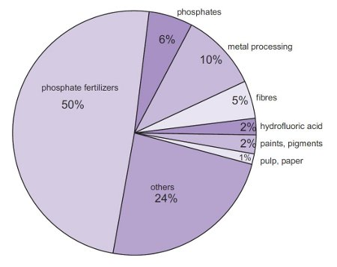
Sulfuric acid
Sulfuric acid is one of the world’s most widely produced chemicals
Half the world production is used in the synthesis of phosphate fertilisers
Also a raw material used in the production of:
Detergents
Explosives
Other acids
Polymers
Pharmaceuticals
Also used in metal extraction and as a catalyst (e.g. in lead acid batteries)

Slide 3
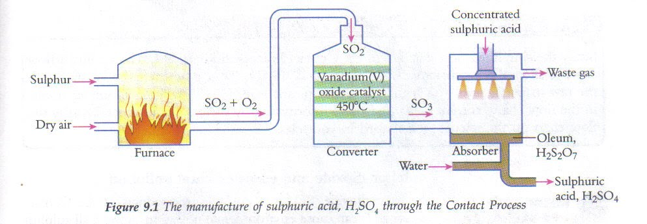
Contact process
Multi step synthesis process using a feed stock of sulfur, oxygen and water.
https://www.youtube.com/watch?v=xjLUJ-7m5v8

Slide 4
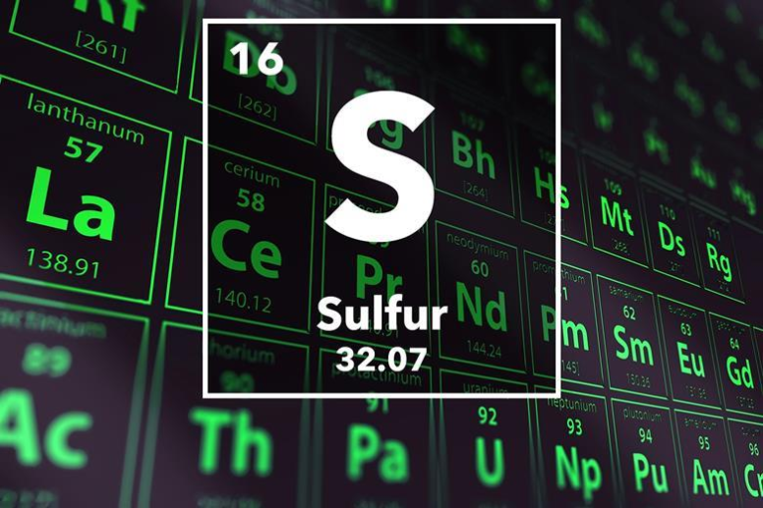
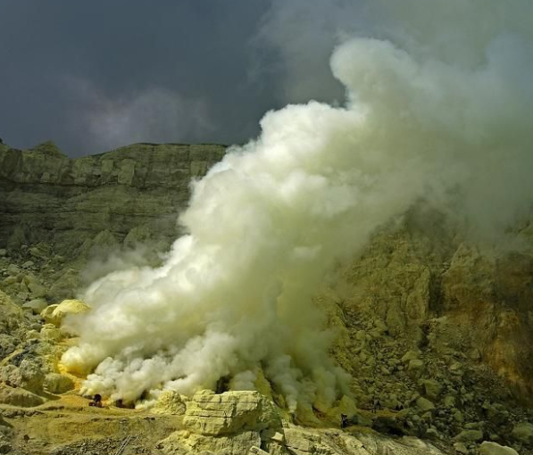
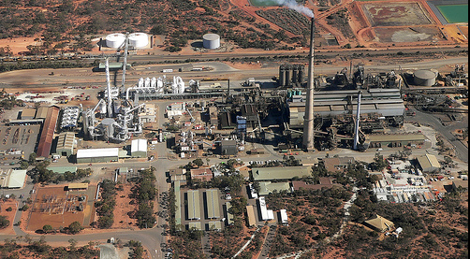
Contact process
Step 1 - oxidation of sulfur (burnt in air)
S (s) + O₂ (g) → SO₂ (g) △H = -297kJ
Reaction is highly exothermic
Waste energy can be used to generate electricity
Alt to burning sulfur – couple sulfuric acid plant with metal sulphide ore smelters (e.g. the nickel smelter in Kambalda WA). They produce waste SO₂, instead of releasing it into the environment it is used in the contact process.

Slide 5
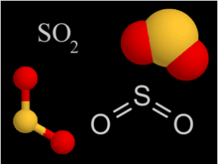
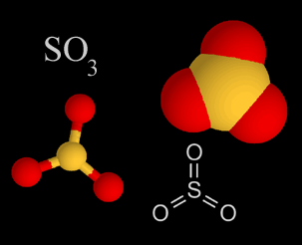
Contact process
Step 2 - reversible reaction to oxidise sulfur dioxide to sulfur trioxide
2 SO₂ (g) + O₂ (g) ⇄ 2 SO₃ (g) △H = -198kJ

Slide 6
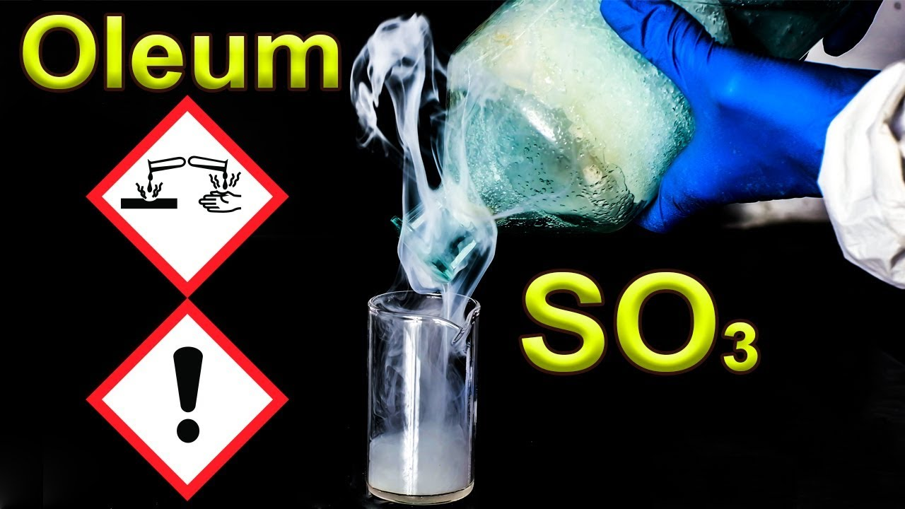
Contact process
Step 3 – sulfur dioxide is dissolved in concentrated sulfuric acid forming oleum
SO₃ (g) + H₂SO₄ (l) → H₂S₂O₇ (l)
Step 4 – water is added to the oleum to produce sulfuric acid
H₂S₂O₇ (l) + H₂O (l) → 2 H₂SO₄ (l)

Slide 7
Contact process - summary
Step 1 - oxidation of sulfur (burnt in air)
S (s) + O₂ (g) → SO₂ (g) △H = -297kJ
Step 2 - reversible reaction to oxidise sulfur dioxide to sulfur trioxide
2 SO₂ (g) + O₂ (g) ⇄ 2 SO₃ (g) △H = -198kJ
Step 3 – sulfur dioxide is dissolved in concentrated sulfuric acid forming oleum
SO₃ (g) + H₂SO₄ (l) → H₂S₂O₇ (l)
Step 4 – water is added to the oleum to produce sulfuric acid
H₂S₂O₇ (l) + H₂O (l) → 2 H₂SO₄ (l)

Slide 8
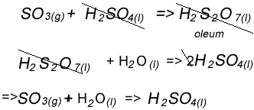
Contact process - optimisation
The overall reaction:
Production optimisation – Only the second step is reversible (formation of SO₃) and its conditions are considered for yield, rate and economic cost.
2 SO₂ (g) + O₂ (g) ⇄ 2 SO₃ (g) △H = -198kJ
Yield? Rate of reaction? Cost?

Slide 9
Contact process - optimisation
TEMPERATURE
Being exothermic, Le Chatelier’s principle predicts higher yield of SO₃ for lower temperatures. With higher temperatures preferred for maximum reaction rate, a compromise is required of about 450 ºC
PRESSURE
High pressures are optimal for both reaction rate and reaction yield. The reaction was found to be acceptable at 1 to 2 times atmospheric pressure and any more would become uneconomical.
EXCESS OXYGEN
Use an excess of O₂, typically 1 mole O₂: 1 mole SO₂ (about twice the required amount of O2). Helps to increase the equilibrium yield of SO₃(g)

Slide 10
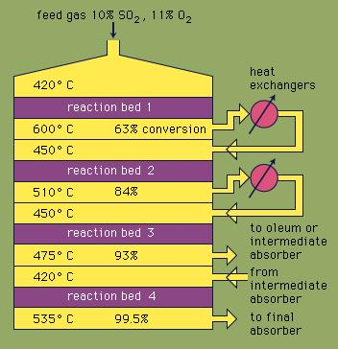
Contact process - optimisation
CATALYST
A catalyst V₂O₅ serves to increase reaction rate with no effect on yield.
The reaction mixture flows through several beds of catalyst each with a decreasing temperature. The initial high temperature bed reacts quickly but does not go to completion. The mixture moving through to the lower temperature results in more conversion of SO₂ to SO₃
Recycling
Yield can be further improved by recycling the unreacted SO_{2(g)}

Slide 11
Contact process - optimisation
SO₃ can react with water to form sulfuric acid, however, it has a low yield and forms a fog of fine droplets that are difficult to recover.
The sulfuric acid produced is 98% H₂SO₄ and has a concentration of about 18 molL⁻¹

